Slide 1
WORLD OF DRONE
Communication with Drones

Slide 2
Communication
Most UAVs use a radio frequency front-end that connects the antenna to the analog-to-digital converter.

Slide 3
Communication
A flight computer controls avionics (and that may be capable of autonomous or semi-autonomous operation).

Slide 4
Radio Signal from Operator Side
It can be issued from
GROUND CONTROL
OR
REMOTE NETWORK SYSTEM

Slide 5
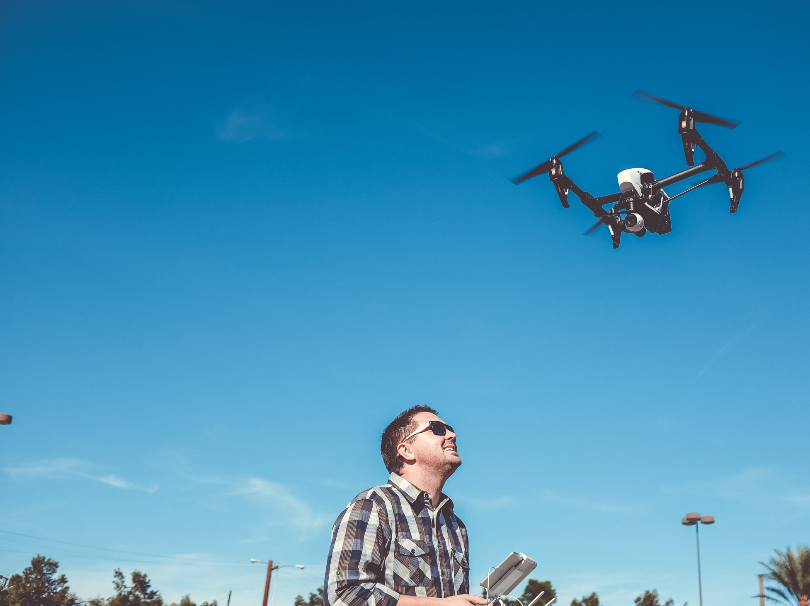
Ground Control
A human operating a radio transmitter/receiver, a smartphone, a tablet, a computer, or the original meaning of a military ground control station (GCS). Recently control from wearable devices, human movement recognition, human brain waves was also demonstrated.

Slide 6
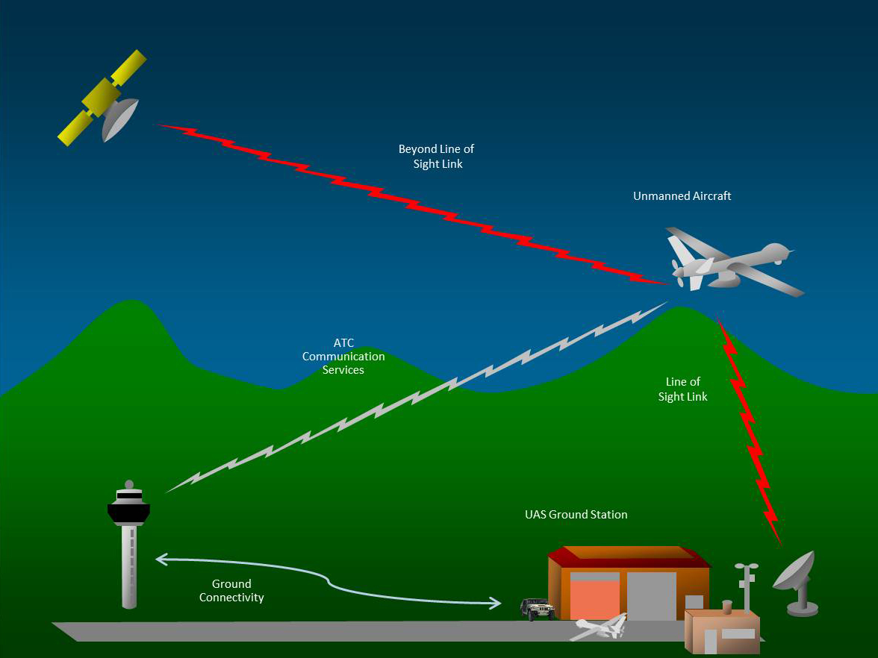
Remote Network System
Satellite duplex data links for some military powers.

Slide 7
?
WELL DONE!
Now you can move on to the next topic...
How Quadcopters Work!

